Slide 1

ENHANCING INSTAGRAM ENGAGEMENT THROUGH DATA-DRIVEN MARKETING
BY ADITYA CHATTERJEE

Slide 2
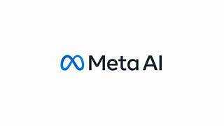
INTRODUCTION
“Behind every like, comment, and follow lies a story that can shape our next growth strategy.”
Through this analysis, multiple insight layers and visualizations have emerged, providing a data-driven foundation to design targeted marketing strategies aimed at improving user engagement, retention, and acquisition. These insights help translate raw interaction data into actionable business decisions that drive sustainable platform growth.

Slide 3
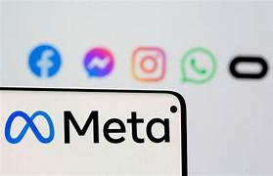
Problem statement
You are hired as a data analyst at Meta and asked to collaborate with Marketing team. Marketing teams wants to leverage Instagram's user data to develop targeted marketing strategies that will increase user engagement, retention, and acquisition. Provide insights and recommendations to address the following objectives

Slide 4
DATA OVERVIEW
comments_id : unique identifier for each comment
comment_text : text content of a given comment
user_id : unique identifier for each user
photo_id : unique identifier for each photo
created_at : date of interaction in the form like, photos, tags
follower_id : user_id of the follower for a certain user
followee_id : user_id of followee for a certain user
tag_id : unique identifier for each tag
image_url : link to the image posted on the platform
username : username chosen by the user
DATABASE LINK:https://drive.google.com/file/d/1wSXXQboFYXgJXxccj4i-cKfIX5QtdPwH/view?usp=drive_link

Slide 5
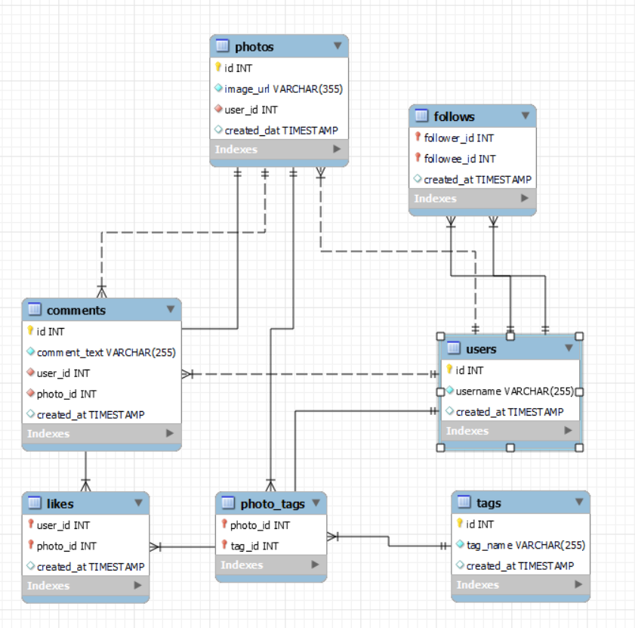
DataBase Schema

Slide 6
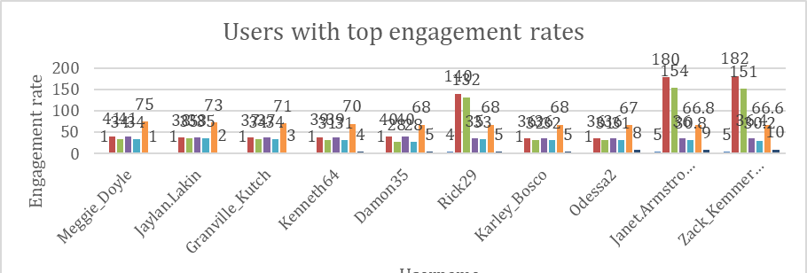
USERS WITH TOP ENGAGEMENT RATES IN LIKES AND COMMENTS

Slide 7
OBSERVATION
Quality beats quantity: Fewer, well-crafted posts often drive higher engagement than frequent posting.
Micro-influencers win per post: Users with moderate followers generate stronger engagement due to loyal, niche audiences.
Comments matter most: Posts with more comments rank higher in engagement, as comments signal deeper, two-way interaction.

Slide 8
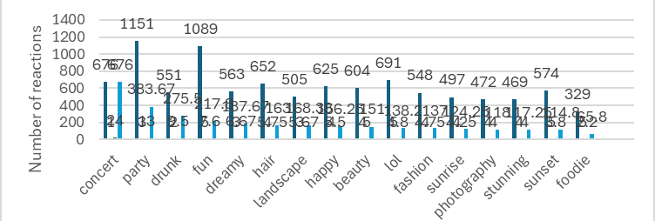
TAG WISE ENGAGEMENT RATE

Slide 9
INSIGHTS REGARTING HASHTAG & TOPIC ENGAGEMENT
Trend-aligned hashtags perform best: Niche, trend-specific hashtags drive higher engagement than broad, generic tags.
Emotional topics spark interaction: Relatable and inspirational themes generate more comments and shares, not just likes.
Visual topics boost visibility: Travel, food, fashion, and art consistently earn higher likes due to strong visual appeal.

Slide 10
RECOMMENDATIONS
Optimize hashtags: Use a balanced mix of trending, high-engagement, and niche hashtags; avoid generic tags.
Build ads on proven topics: Align creatives with data-backed, high-performing themes to stay native and relevant.
Partner with niche influencers: Collaborate with creators who drive loyal, interactive audiences for higher authenticity.
Strategic Impact
📈 Higher engagement & discoverability
🎯 Improved ad relevance & conversions
🤝 Stronger creator–brand partnerships

Slide 11
CRUCIAL PLAY OF POSTING HOURS IN THE ENGAGEMENT OF THE RATE OF USERS

Slide 12
INSIGHTS ON POSTING HOURS AND ENGAGEMENT RATE
6–9 PM (Peak): Highest likes & comments as users unwind after work/school.
7–9 AM (Secondary peak): Good for quick, motivational or informative content.
12–2 PM (Moderate): Steady activity but highly competitive—content must stand out.
10 PM–2 AM (Low): Limited engagement; works only for night-active audiences.
2–6 AM (Minimal): Least effective—posts get buried later.

Slide 13
Recommendations for Content Strategy
Post in prime hours: Schedule content between 6–9 PM for maximum reach and engagement.
Match content to mindset:
  Morning → Inspirational, productivity-focused, quick reads
  Evening → Entertaining, emotional, community-driven
Avoid off-hours: Post late night or early morning only for specific time zones or night-active users.
Strategic Takeaway
⏰ Smart timing aligned with user behavior drives higher visibility, engagement, and performance.

Slide 14
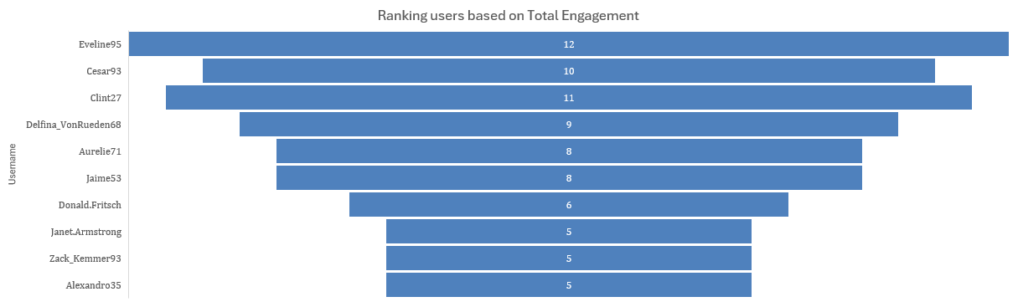
RANKING USERS BY TOTAL ENGAGEMENT

Slide 15
OBSERVATIONS
Engagement Rate
Formula: (Likes + Comments) ÷ Total Followers
Purpose: Measures how actively a user’s audience interacts with their content.
Engagement-Based Segmentation
Classify users using total likes, comments, and post volume.
Segment into high, medium, and low engagement groups for targeted analysis and strategy.

Slide 16
CATEGORIZING USERS BASED ON ENGAGEMENT LEVELS

Slide 17
VARIETIES OF SEGMENTATIONS
Segmentation by Engagement Level
Classify users using total likes, comments, and post frequency.
Group users into high, medium, and low engagement segments for targeted insights and actions.

Slide 18
FINAL RECOMMENDATIONS
Ad Strategy Optimization
Performance segmentation: Analyze results by demographics, device, and timing to refine targeting and scheduling.
A/B testing: Continuously test creatives, messaging, and CTAs to improve performance.
Retargeting & personalization: Re-engage non-converters with tailored follow-ups based on past interactions.
Content & trend alignment: Match ads with trending hashtags, user interests, and high-performing themes.
Summary
📊 Data-driven segmentation + continuous experimentation + relevant content = scalable, high-impact, cost-efficient ad campaigns.

Slide 19

“Every moment spent on social media is an investment—and data tells us how well that investment performs.”

